Slide 1
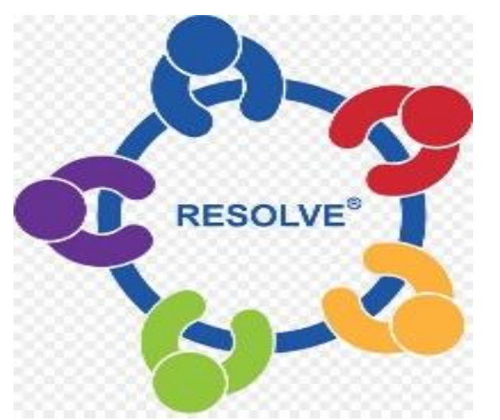
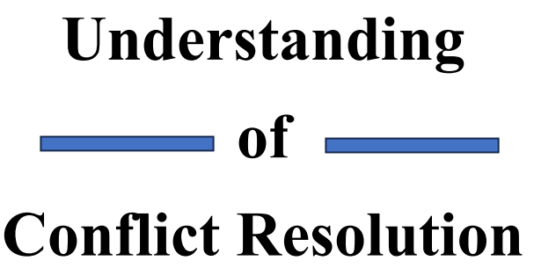

Chapter Two: Types And Dynamics Of Conflicts

Slide 2
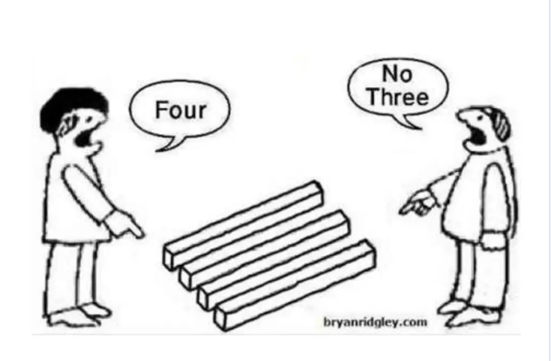

Slide 3
Introduction
Conflict is a universal phenomenon that can arise in any setting where people interact.
It can manifest in various forms, including interpersonal, intergroup, and organizational conflicts.
Understanding the dynamics of conflicts is essential for resolving them and preventing them from escalating into violence.

Slide 4
Types of Conflict
Conflicts can arise in various forms and occur in different contexts. Here are some common types of conflicts and their dynamics:
Intrapersonal Conflict: Intrapersonal conflicts occur within an individual's mind.
Interpersonal Conflict: This type of conflict occurs between individuals.
Intra-organizational Conflict: Intra-organizational conflicts occur within an organization, among its members or different departments.
Intergroup Conflict: Intergroup conflicts occur between different groups or teams
International Conflict: International conflicts occur between nations or states.

Slide 5
Dynamics of Conflict
The dynamics of conflict refer to the patterns, processes, and stages that conflicts go through as they develop and evolve.
Understanding these dynamics can provide insights into the underlying causes, behaviors, and potential resolutions of conflicts.
Authors and researchers have proposed several models that describe the stages a conflict typically goes through.

Slide 6
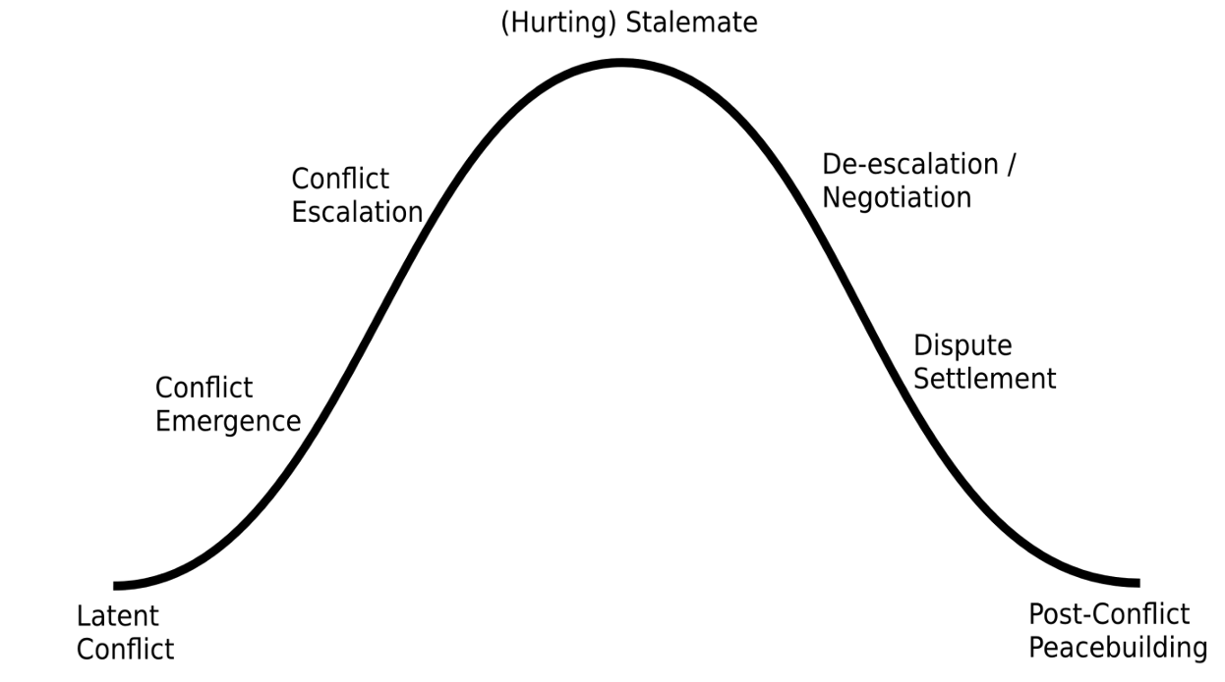
Dynamics of Conflict

Slide 7
Dynamics of Conflict
Latent Conflict: This is a situation where there are differences of viewpoint and things that bother individuals or parts of a group. This stage can also be described as “unstable peace”.
Conflict Emergence: Where a conflict has remained latent for a period, this stage marks the point that it emerges.
Conflict Escalation: During the escalation stage the intensity of a conflict increases and how individuals and groups interact begins to divide them.

Slide 8
Dynamics of Conflict
Hurting/Stalemate: Once conflicts escalate for a while, they often reach a stalemate: a situation in which neither side can win, but neither side wants to back down or accept loss either.
De-escalation / Negotiation: Having arrived at a stalemate and a situation that neither side can win, a shift of emphasis can occur that cools the tension and a willingness to move in a different direction emerges.
Dispute Settlement: New or greatly changed collective identities become dominant. Grievances underlying the conflict are often reduced for one side, but to resolve the conflict, the other side's grievances must be minimized.

Slide 9
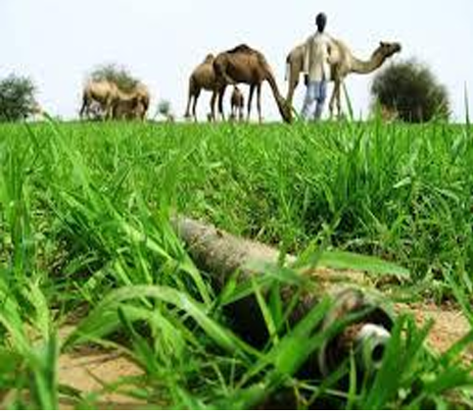
Post-Conflict Peacebuilding
Even after a settlement is reached, this is by no means the end of the conflict. The settlement must be implemented.
The key to transforming conflict is to build strong equitable relations.
Overall, understanding the dynamics of conflict can help individuals, groups, and societies navigate conflicts more effectively and work towards sustainable resolutions.
It allows for the identification of key stages, behaviors, and intervention points to manage conflict construction.

Slide 10

Conflict Management Approaches
Conflict management involves understanding the causes and dynamics of conflicts, employing strategies to de-escalate tensions, and finding mutually beneficial solutions.
Effective conflict management aims to minimize negative consequences, promote open communication, and maintain or strengthen relationships.
Conflict management methods can be broadly classified into two categories: coercive and non coercive (Alternative Dispute Resolution) approaches.

Slide 11
Conflict Management Approaches
Coercive Methods
Coercive methods refer to approaches used to manage conflicts that rely on the use of force, power, or authority to impose a resolution or enforce compliance.
These methods typically involve one party exerting control or dominance over the other party, often resulting in a win lose outcome and potentially damaging relationships
Coercive methods are generally considered less desirable for managing conflicts because they can lead to negative outcomes such as increased hostility, damaged relationships, and long-term resentment.

Slide 12
Conflict Management Approaches
Here are some examples of coercive methods:
Force or Physical Coercion: This involves using physical strength or violence to control or suppress conflicts.
Authority or Hierarchy: Coercive methods can be based on the hierarchical power structure within an organization or society
Punishment or Threats: Coercive methods may include imposing punishments or making threats to force compliance or deter certain behaviors. This can involve disciplinary actions, financial penalties, or negative consequences for those who do not conform to the desired outcome.

Slide 13
Conflict Management Approaches
Non-Coercive Methods (Alternative Dispute Resolution)
Non-coercive methods, are approaches used to manage conflicts that prioritize collaboration, communication, and mutual agreement rather than relying on force or authority.
ADR methods aim to facilitate constructive dialogue, promote understanding, and find mutually acceptable solutions.
They are often used as alternatives to traditional litigation or coercive methods.

Slide 14
Conflict Management Approaches
Here are some commonly used non-coercive methods of ADR:
Mediation: Mediation involves the assistance of a neutral third party, the mediator, who facilitates communication and guides the parties toward a mutually acceptable resolution.
Negotiation: Negotiation involves direct communication and discussion between the conflicting parties to reach a mutually acceptable solution.
Collaboration: Collaboration emphasizes working together to find win-win solutions. It involves active participation, shared decision-making, and joint problem-solving.

Slide 15
Conflict Management Approaches
Arbitration: Although arbitration is classified as a coercive method, it is a more formalized approach compared to the previous examples. In arbitration, a neutral third party, known as an arbitrator, listens to the arguments from both sides and makes a binding decision to resolve the conflict.
Facilitation: Facilitation involves the use of a neutral facilitator who guides a group or team through a structured process to address conflicts effectively
Consensus-Building: Consensus-building focuses on reaching a collective agreement that satisfies the interests and concerns of all parties involved. It involves open discussion, active listening, and seeking common ground.

Slide 16
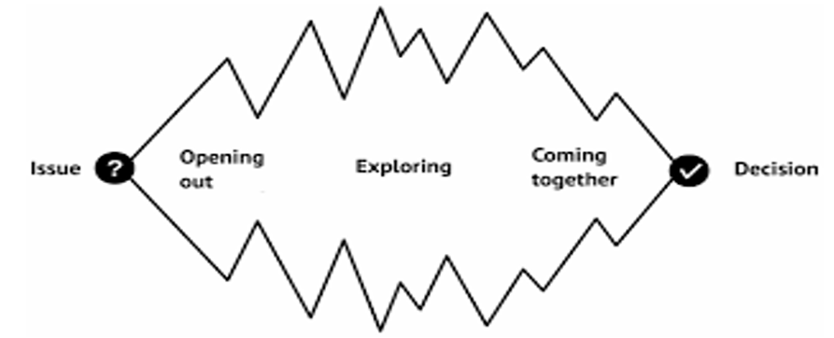
Conflict Management Approaches

Slide 17
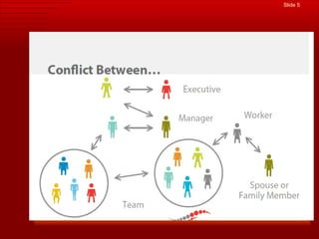
.

Slide 18
Chapter assessment( questions)
1- define Dynamics of Conflict.
2- list the types of conflict
3) what are the commonly used non-coercive methods of ADR:?
4) give example for commonly used non-coercive methods of ADR?
5) state the other way that we can describe “Latent Conflic”
6) what does it mean “Post-Conflict Peacebuilding “

Slide 19
The END
Any Question?

